Slide 1

Paul Binyan
Hebrew Verbs Conjugation
Grammar and Quiz
By Olga Liberzon & Daniil Liberzon

Slide 2
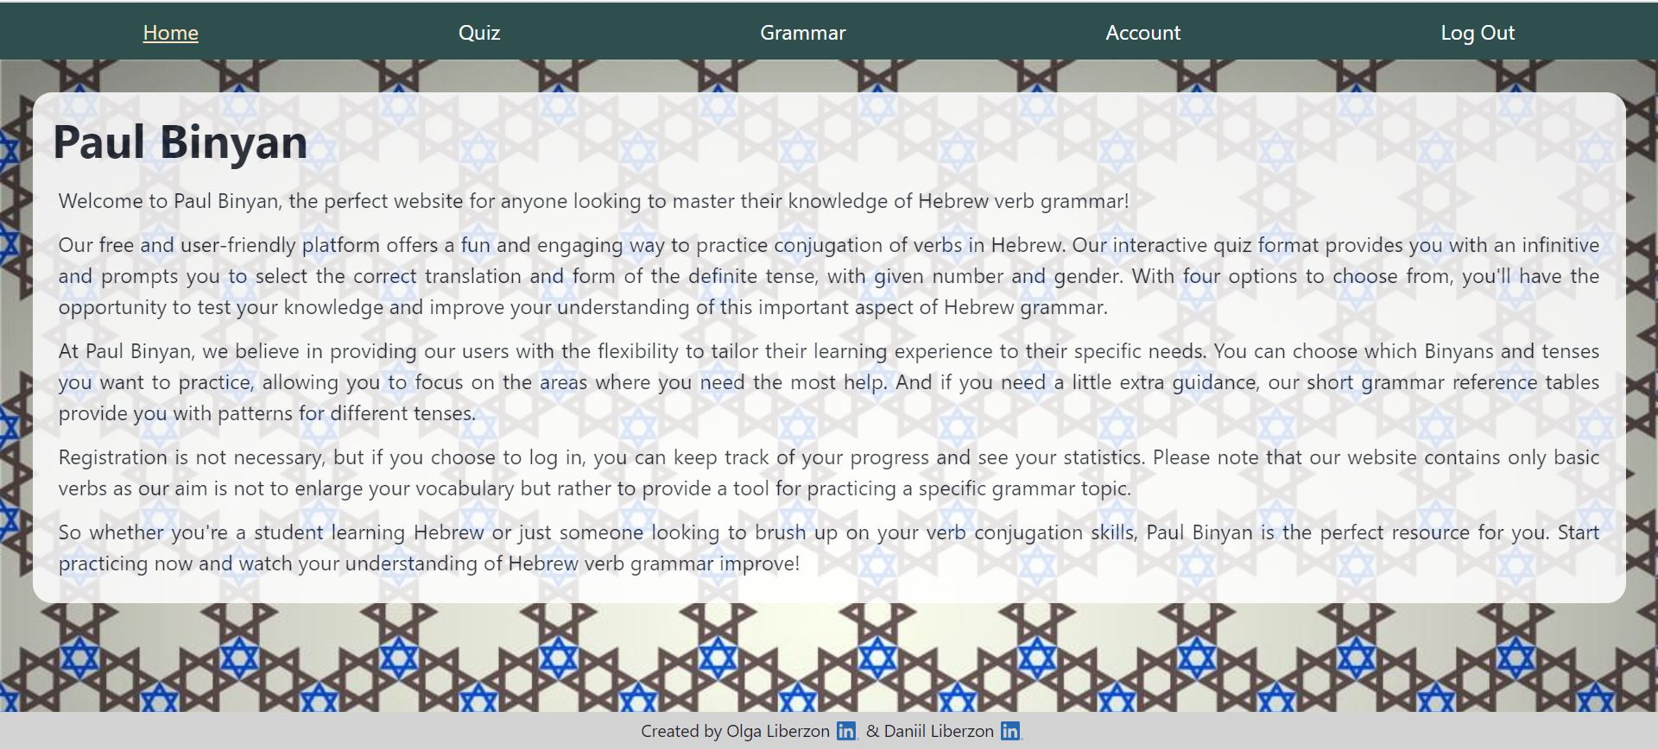
Paul Binyan – website about Hebrew verbs grammar
Quiz – improve your skills of verbs conjugation
Grammar – learn some theory
Account – keep your progress

Slide 3
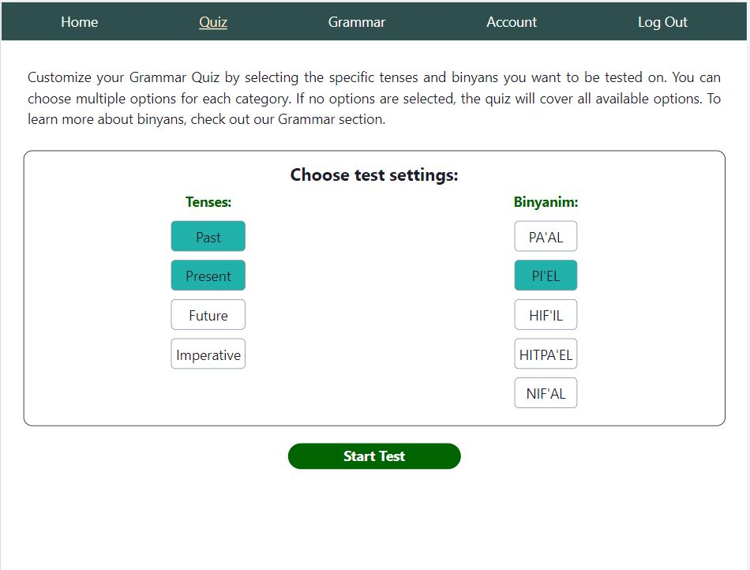
Quiz : settings

Slide 4
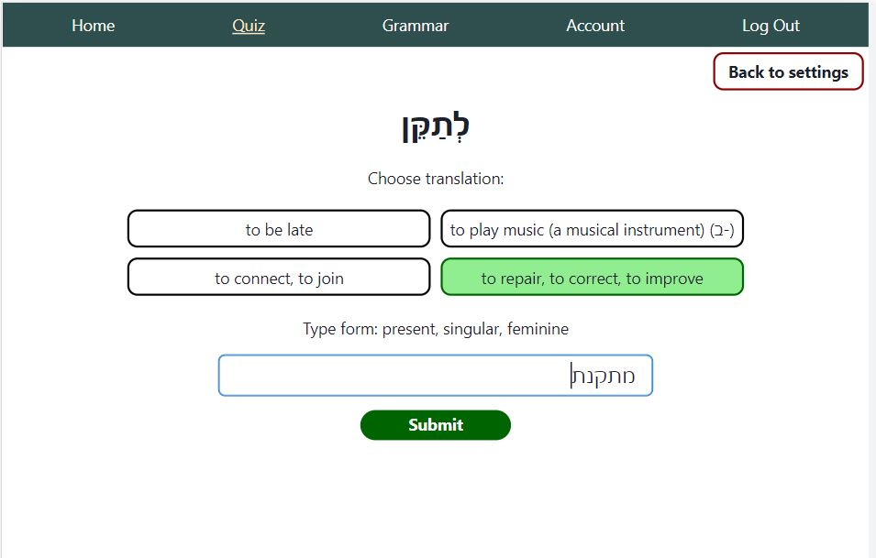
Quiz : question

Slide 5
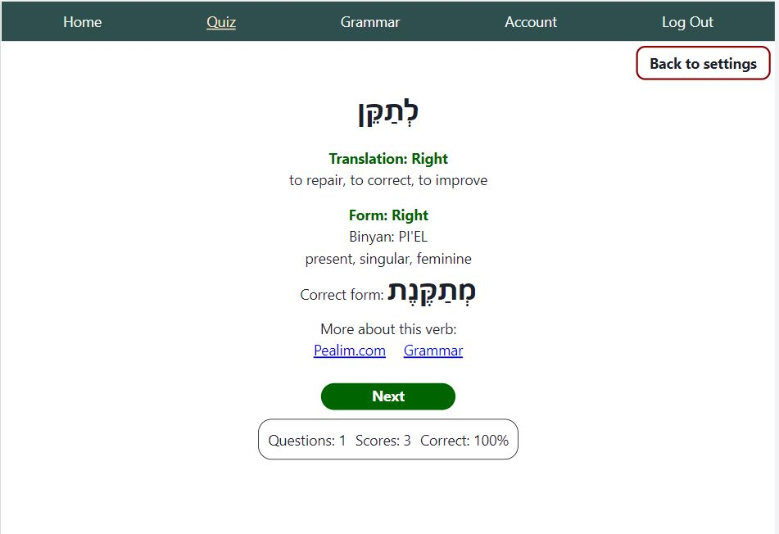
Quiz : answer

Slide 6

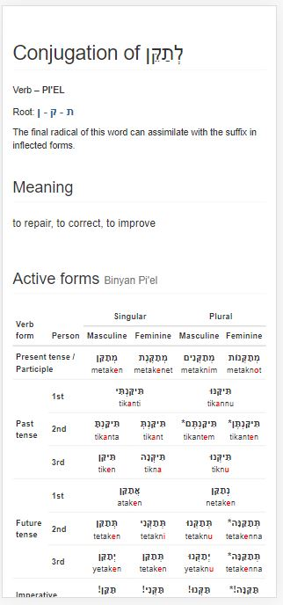
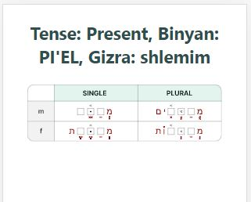
Quiz : answer. Links

Slide 7
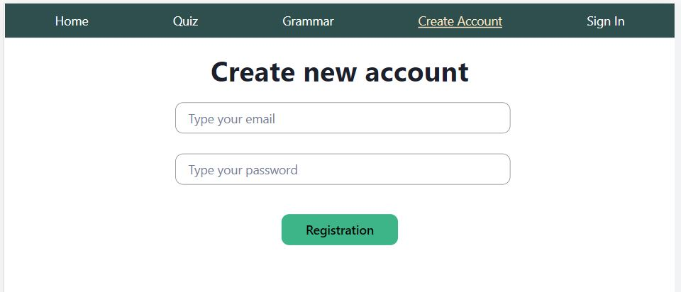
Create Account or Sign In

Slide 8
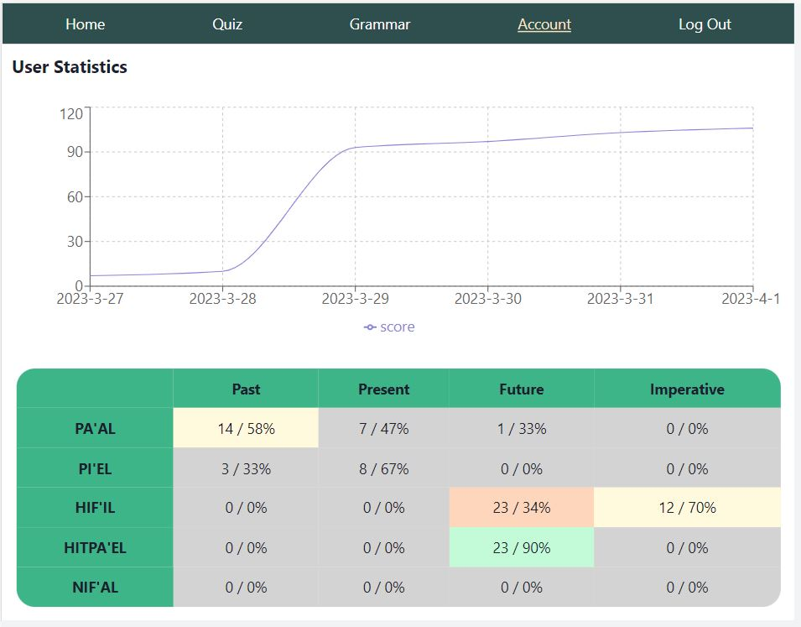
Account
Keep your progress: check dynamics of your scores and see topic details
- not enough data
- poor
- moderate
- excellent

Slide 9
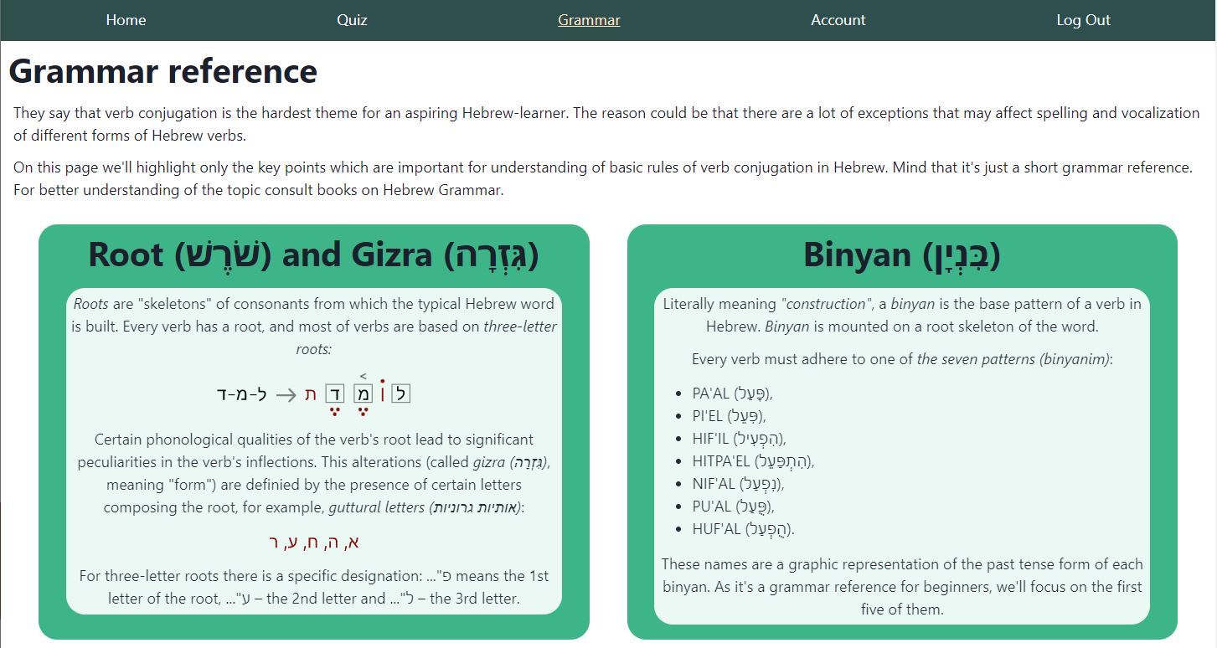
Grammar

Slide 10
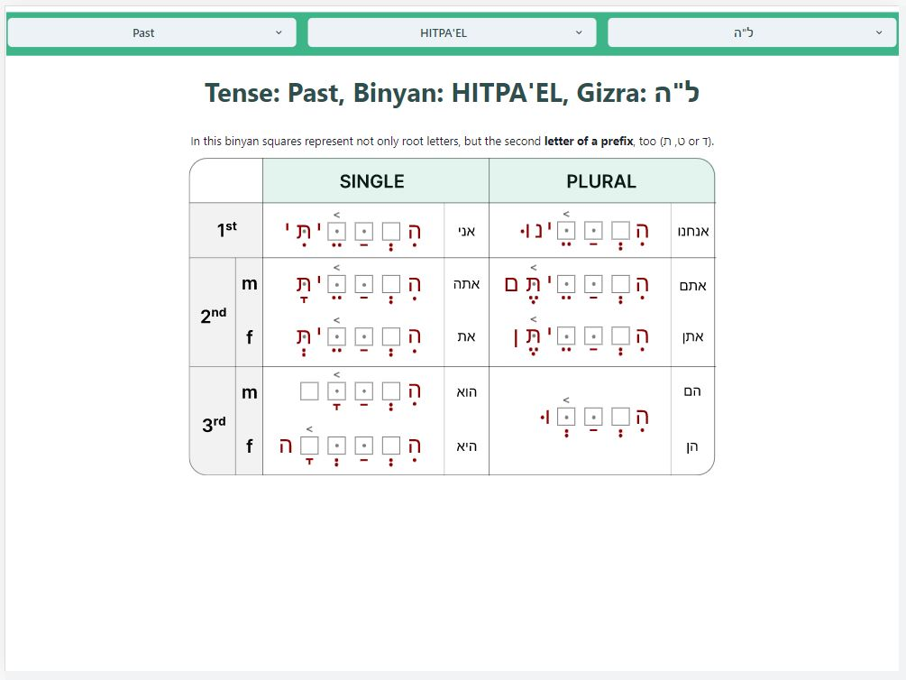
Grammar: table

Slide 11



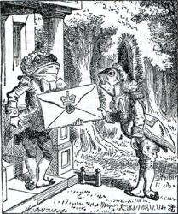







Technical stuff
Data gathering and preprocessing (verbs forms and translation)
Project Management
Beautiful Soup
Content development (Grammar Tables)
Front-end
Server side

Slide 12
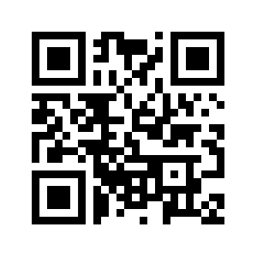
Visit Paul Binyan Now!

